Slide 1


SQL Analysis of Amazon Sales Data in Myanmar
This presentation covers an SQL analysis of Amazon sales data. The data is from Myanmar. The analysis includes sales trends, customer behavior, and product performance.
by Savan Patel

Slide 2
Data Overview: Time and Region
Temporal Scope
Top Performing Region
Data covers one year (2019).
According to the data,
Three months included: Jan, Feb, Mar.
Naypyitaw leads in revenue generation.
January shows the highest sales volume.

Slide 3

Branches and Origin Country
Branch Locations
Branch A: Yangon
Branch B: Mandalay
Branch C: Naypyitaw
Country of Origin
The dataset pertains to sales data from:
Myanmar.

Slide 4
Product Lines and SQL Query Structure
Key Product Lines
SQL Query Order
Health and beauty
SQL queries follow a specific order:
Electronic accessories
SELECT
Home and lifestyle
FROM
Sports and travel
WHERE
Food and beverages
GROUP BY
Fashion accessories
HAVING
ORDER BY

Slide 5




Product Sales Analysis
Analysis Focus
Product line performance.
Top Seller
Food and beverages drive the highest sales.
Lowest Sales
Health and beauty lags in sales volume.

Slide 6

Customer Behavior Insights
Customer behavior impacts sales trends and strategies.
Key analysis points follow.

Slide 7
Customer and Sales Analysis
Customer Insights
Sales Insights
Members pay highest taxes.
Highest ratings in the afternoon.
Customer types: member, normal.
Monday: highest avg rating (7.15).
Members purchase most often.
Branch-specific high ratings on Friday.
Female customers buy more.

Slide 8
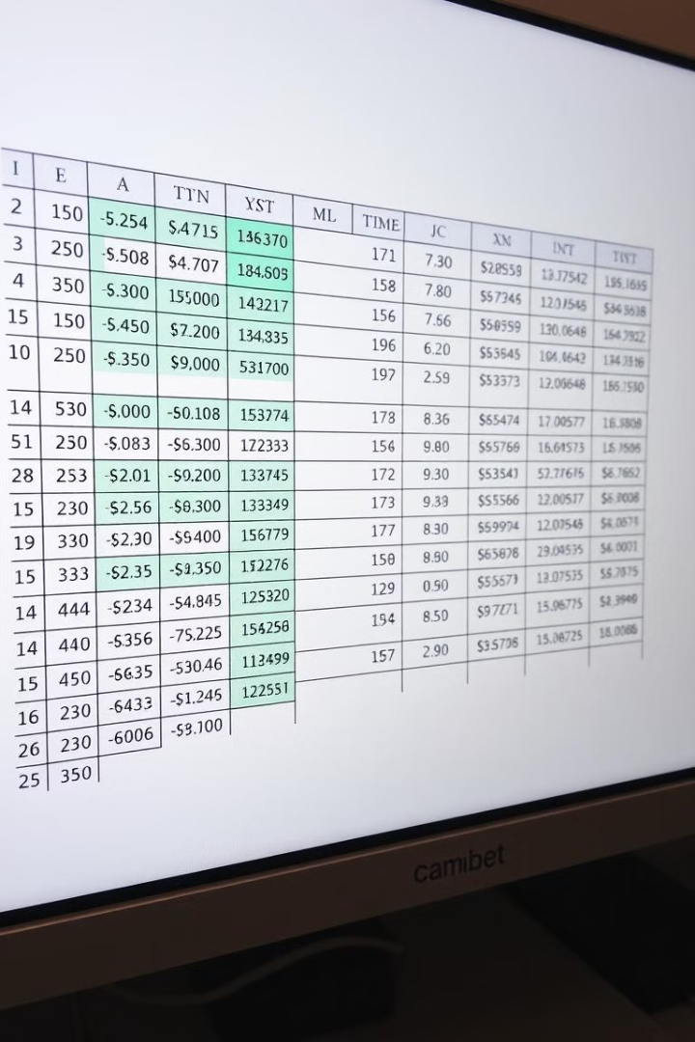
Dataset Structure
Numerical Columns
Categorical Columns
Total: 8
Total: 10
Database Shape
Rows: 1000
Columns: 20

Slide 9
Top Product and SQL Execution Order
Most Purchased Product
SQL Execution Order
Food and beverages: Sales $56144.844.
FROM
JOIN
WHERE
GROUP BY
HAVING
SELECT
DISTINCT
ORDER BY
LIMIT / TOP

Slide 10
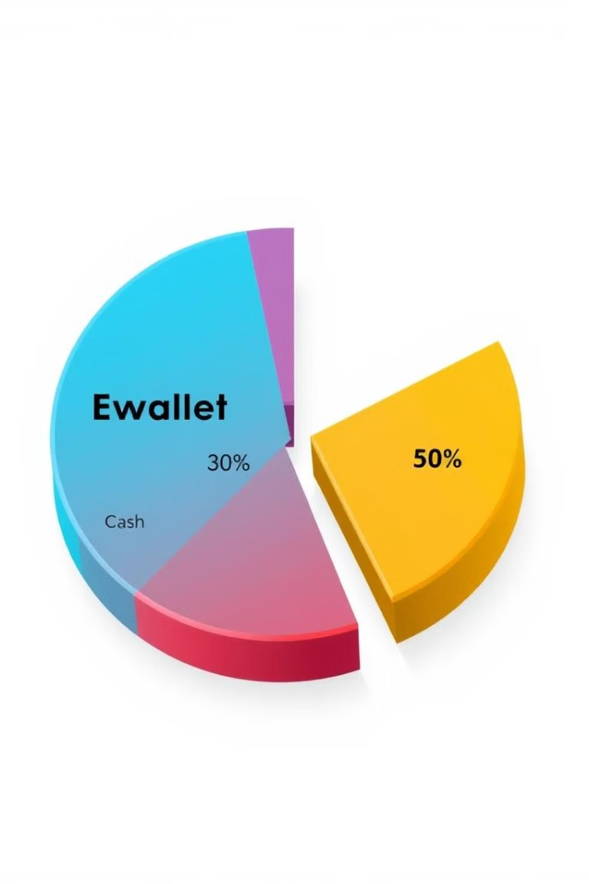
Payment Methods
Payment Methods
Ewallet: 345
Cash: 344
Credit card: 311
Insights
Ewallet and Cash are most used.
Credit card is less common.

